Slide 1

Academic Writing (BETA) Week 4, Lecture
Anna Martonfi
a.martonfi@vu.nl
Vrije Universiteit Amsterdam

Slide 2

https://static01.nyt.com/images/2011/03/23/dining/23veggieburger-span/VeggieBurger-jumbo.jpg

Slide 3




http://joelnanauka.com/wp-content/uploads/2016/01/how-to-talk-to-public-crowds.jpg
http://designtoimprovelife.dk/wp-content/uploads/2013/06/library-1024x691.jpg
http://www.novinite.com/media/images/2012-11/photo_verybig_145483.jpg
http://cx.aos.ask.com/question/aq/1400px-788px/business-solution_f4b4a1bcf89fb9d9.jpg

Slide 4

https://blo88er.files.wordpress.com/2014/12/information-overload.jpeg

Slide 5
Title
Introduction paragraph
Body paragraph 1
Body paragraph 2
Body paragraph 3
Conclusion
List of references

Slide 6
Title
Introduction paragraph
Body paragraph 1
Body paragraph 2
Body paragraph 3
Conclusion
List of references

Slide 7
Today: Paragraphs
What is a paragraph?
Why would you use paragraphs?
How do you write a paragraph?

Slide 8

What is a paragraph and why would you use it?
http://www.familytree.com/wp-content/uploads/2013/10/doing-research.jpg

Slide 9
What is a paragraph?
A recognizable unit in your text
One paragraph = one step in your argumentation

Slide 10
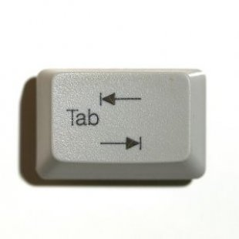
paragraphS: Layout
Starts with an indent and ends with a hard return

Slide 11
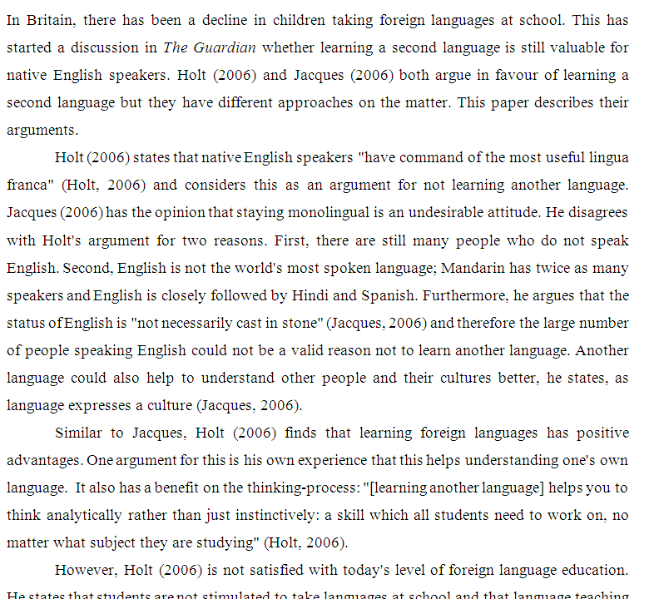
Clear where paragraphs start (indentation), roughly the same length

Slide 12
Example paragraph

Slide 13
In the area of user-focused security, there is limited data and analysis of user motivation regarding their security posture and behavior. Weirich and Sasse [17] report the results of a series of user interviews about password behavior and develop suggestions of how to phrase arguments to persuade users to adopt better security behavior. Stanton et al. [18] likewise interviewed users for the purpose of discovering the range of user security behavior in a wide variety of contexts—not just in password choice and use. The laboratory-based user studies that the authors are familiar with mostly attempt to test new security systems, such as the evaluation of Deja Vu by Dhamija and Perrig [19] and one of the evaluations of the PassPoints system such as done by Wiedenbeck et al. [20].
From: Hugh Wimberly & Lorie M. Liebrock (2011). Using Fingerprint Authentication to Reduce System Security: An Empirical Study.

Slide 14
In the area of user-focused security, there is limited data and analysis of user motivation regarding their security posture and behavior. Weirich and Sasse [17] report the results of a series of user interviews about password behavior and develop suggestions of how to phrase arguments to persuade users to adopt better security behavior. Stanton et al. [18] likewise interviewed users for the purpose of discovering the range of user security behavior in a wide variety of contexts—not just in password choice and use. The laboratory-based user studies that the authors are familiar with mostly attempt to test new security systems, such as the evaluation of Deja Vu by Dhamija and Perrig [19] and one of the evaluations of the PassPoints system such as done by Wiedenbeck et al. [20].
From: Hugh Wimberly & Lorie M. Liebrock (2011). Using Fingerprint Authentication to Reduce System Security: An Empirical Study.

Slide 15
In the area of user-focused security, there is limited data and analysis of user motivation regarding their security posture and behavior. Weirich and Sasse [17] report the results of a series of user interviews about password behavior and develops suggestions of how to phrase arguments to persuade users to adopt better security behavior. Stanton et al. [18] likewise interviewed users for the purpose of discovering the range of user security behavior in a wide variety of contexts—not just in password choice and use. The laboratory-based users studies that the authors are familiar with mostly attempt to test new security systems, such as the evaluation of Deja Vu by Dhamija and Perrig [19] and one of the evaluations of the PassPoints system such as done by Wiedenbeck et al. [20].
From: Hugh Wimberly & Lorie M. Liebrock (2011). Using Fingerprint Authentication to Reduce System Security: An Empirical Study.

Slide 16
In the area of user-focused security, there is limited data and analysis of user motivation regarding their security posture and behavior. Weirich and Sasse [17] report the results of a series of user interviews about password behavior and develops suggestions of how to phrase arguments to persuade users to adopt better security behavior. Stanton et al. [18] likewise interviewed users for the purpose of discovering the range of user security behavior in a wide variety of contexts—not just in password choice and use. The laboratory-based users studies that the authors are familiar with mostly attempt to test new security systems, such as the evaluation of Deja Vu by Dhamija and Perrig [19] and one of the evaluations of the PassPoints system such as done by Wiedenbeck et al. [20].
From: Hugh Wimberly & Lorie M. Liebrock (2011). Using Fingerprint Authentication to Reduce System Security: An Empirical Study.

Slide 17
Putting paragraphs to the test

Slide 18
Example: Related Work, paragraph 1
At the University of Maryland, the International Communication and Negotiation Simulations (ICONS) project has been running for over twenty years now as a tool for teaching students on international relations and conflict resolutions, mainly based on bilateral negotiation simulations and role-playing [12].
From: Raz Lin, Yinon Oshrat and Sarit Kraus. Investigating the Benefits of Automated Negotiations in Enhancing People’s Negotiation Skills. 2009

Slide 19
Example: Related Work, paragraph 2
Ross et al. [17], on the other hand, investigate how the negotiation skills of students in relevant courses can be improved.
From: Raz Lin, Yinon Oshrat and Sarit Kraus. Investigating the Benefits of Automated Negotiations in Enhancing People’s Negotiation Skills. 2009

Slide 20
Example: Related Work, paragraph 3
Similar to Ross et al. Druckman and Ebner [3] conducted an experiment in which they demonstrated that students practicing in simulations demonstrate a better understanding of negotiation concepts.
From: Raz Lin, Yinon Oshrat and Sarit Kraus. Investigating the Benefits of Automated Negotiations in Enhancing People’s Negotiation Skills. 2009

Slide 21
Example: Related Work, paragraph 4
Lastly, Kenny et al. [6] and Traum et al. [15] describe work on virtual humans that are used for interpersonal training for skills, such as: negotiation, leadership, interviewing and cultural training.
These four topic sentences should give a general idea of what is discussed in the whole section. It only works, of course, if the topic sentences really cover the content of the paragraphs, so no additional studies are discussed (in this case).
From: Raz Lin, Yinon Oshrat and Sarit Kraus. Investigating the Benefits of Automated Negotiations in Enhancing People’s Negotiation Skills. 2009

Slide 22

How do you write a paragraph?
http://cohoctonlibrary.org/wp-content/uploads/2014/06/Bookshelves-Background.jpg

Slide 23
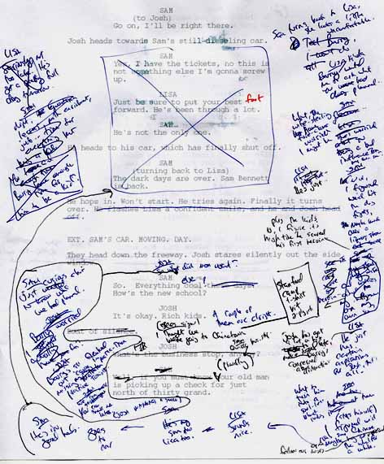
1. Decide on one theme or topic and stick to it
Writing is a messy process…
Everyone writes differently:
plan > execution
writing > idea > plan
write, rewrite, rewrite
So, check and re-check.
http://annawrites.com/blog/wp-content/uploads/2011/03/rewriting-mess.jpg

Slide 24

2. Announce what you’re going to talk about (the topic sentence)
Ross et al. [17], on the other hand, investigate how the negotiation skills of students in relevant courses can be improved.
There are three advantages to the model by Jones.
http://thenewagentblog.com/wp-content/uploads/2015/03/announcement-megaphone-1140x641.jpg

Slide 25
3. Present the information in a logical order, example 1
Meditation is a good way to relax. It is an activity that one can do without any outside interference. Moreover, it can help people forget about their everyday stresses, by focusing on their internal energies. While meditation does soothe the mind, it also helps to loosen a person's physical body. Through silence and concentration, meditation can help a person lead a more relaxing lifestyle.

Slide 26
3. Present the information in a logical order, example 1
Meditation is a good way to relax. It is an activity that one can do without any outside interference. Moreover, it can help people forget about their everyday stresses, by focusing on their internal energies. While meditation does soothe the mind, it also helps to loosen a person's physical body. Through silence and concentration, meditation can help a person lead a more relaxing lifestyle.

Slide 27
3. Present the information in a logical order, example 2
The nuclear attacks on Hiroshima and Nagasaki were the culmination of a six-month firebombing campaign begun in March 1945. By the time work on a nuclear weapon was near completion at the Los Alamos National Laboratory, a number of Japanese cities were selected as possible targets for a nuclear attack. The first atomic bomb test took place on July 16 near Alamogordo, New Mexico. When President Truman and other Allied leaders issued the Potsdam Declaration on July 26, Japan rejected the proposed terms of surrender. Truman then issued orders authorizing nuclear attacks. The first atomic bomb was dropped on Hiroshima on August 6, followed by a second atomic bomb over Nagasaki on August 9. Japan surrendered to the Allies on August 15 and signed the Instrument of Surrender on September 2, marking the end of World War II.

Slide 28
3. Present the information in a logical order, example 2
The nuclear attacks on Hiroshima and Nagasaki were the culmination of a six-month firebombing campaign begun in March 1945. By the time work on a nuclear weapon was near completion at the Los Alamos National Laboratory, a number of Japanese cities were selected as possible targets for a nuclear attack. The first atomic bomb test took place on July 16 near Alamogordo, New Mexico. When President Truman and other Allied leaders issued the Potsdam Declaration on July 26, Japan rejected the proposed terms of surrender. Truman then issued orders authorizing nuclear attacks. The first atomic bomb was dropped on Hiroshima on August 6, followed by a second atomic bomb over Nagasaki on August 9. Japan surrendered to the Allies on August 15 and signed the Instrument of Surrender on September 2, marking the end of World War II.

Slide 29
3. Present the information in a logical order, example 3
David Letterman and Jay Leno, while both are late night talk-show hosts, have very different personalities. Letterman often makes jokes at his own expense; however, Leno tends to laugh at others. Also, Letterman exhibits a closer relationship with his fans than Leno does. Furthermore, Letterman has a more natural, sincere interviewing technique than that of Leno.

Slide 30
3. Present the information in a logical order, example 3
David Letterman and Jay Leno, while both are late night talk-show hosts, have very different personalities. Letterman often makes jokes at his own expense; however, Leno tends to laugh at others. Also, Letterman exhibits a closer relationship with his fans than Leno does. Furthermore, Letterman has a more natural, sincere interviewing technique than Leno.

Slide 31
TO sum up: Three important aspects of writing good paragraphs
thematic unity
a clear topic sentence, which announces the theme and/or goal of the paragraph
a logical internal structure

Slide 32
So, What about that hamburger?
http://cohoctonlibrary.org/wp-content/uploads/2014/06/Bookshelves-Background.jpg

Slide 33
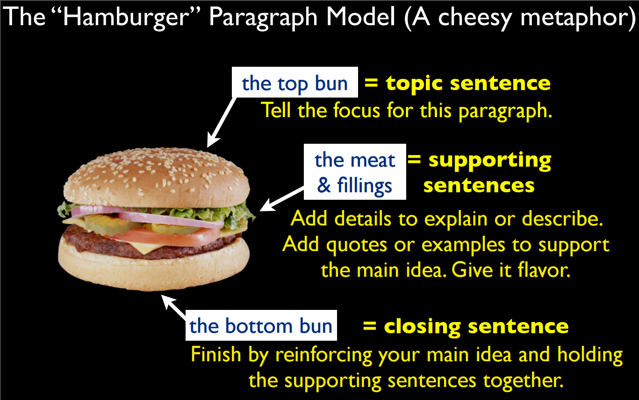
https://al9.wikispaces.com/file/view/Making+paragraphs+meaty.pdf

Slide 34
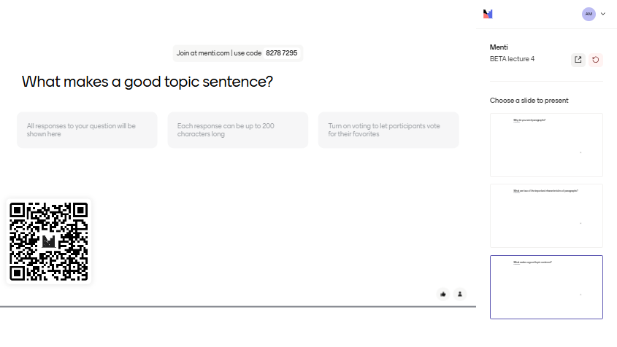

Slide 35
The two-minute paper
Take a pen and paper, or your laptop, and write down the answers to the following questions:
Why do you need paragraphs?
What are two of the important characteristics of paragraphs?
What makes a good topic sentence?

Slide 36
Coming up next…
This week’s seminar:
Improving draft paragraphs
Linking language: turning a list into a story
Next week (week 5): NO CLASSES
The week after (week 6):
The structure of conclusions
Punctuation

